Slide 1
STRATEGY PATTERN
A patterns-box talk
by
Jose Palacios

Slide 2
About me
Hi, I’m Jose, Software Engineer 3 at Belatrix. Currently I’m working at La Familia Team on the convertion modules

Slide 3
01
02
03
04
Goal
Real world case
Architecture
Problems it solves

Slide 4
05
06
07
08
When to use it?
When not to use it?
Common mistakes
Advantages

Slide 5
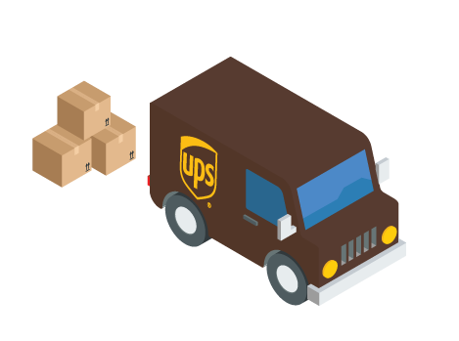


Real world case
Notes:
Let’s start with a real world case
The idea here is that we have a customer who is checking out a website and we need to calculate the shipping order to them, now the cost may vary depending on how the customer has chosen they want the package to arrive, the customer has the choise of choosing FEDEX , UPS and the united states postal service and depending on wich carrier the customer has chosen during the checkout process .

Slide 6
Goal
Define a family of algorithms, encapsulate each one, and make them interchangeable. Strategy lets the algorithm vary independently from clients that use it.
Notes:
The main idea is to identify the parts of your program that vary and separate them from what stays the same.

Slide 7
Architecture
Context
Interface
(IShippingCalculation)
Concrete Strategies
FedExStrategy
7.5 * km
UPSStrategy
5 * km
Notes:
Here we have a context class, this class will ask to actually do the work.In its construction, it takes an instance, a concrete instance of a class that implements our strategy interface. this interface declares a method that will be the one called by the context class to actually perform the calculation we're interested in performing. Now this context will perform an action could be an user input for example, and it would then use the strategy that it was given on its constructor to call shippingCalculation on a concrete class and in this case we have two concrete implementations of our strategy interface

Slide 8

Problems it solves
Exchanging methods, behaviours at run-time
Inflexible code
Duplicated code
Notes:
*The Strategy design pattern solves problems like:
How can a class be configured with a method at run-time
instead of implementing an method directly?
How can an algorithm be selected and exchanged at run-time?
*How can hard-wired algorithms (compile-time implementation dependencies) be refactored?
*How can many related classes that differ only in their implementations be replaced
by a common class that is configured with one of many implementations?

Slide 9
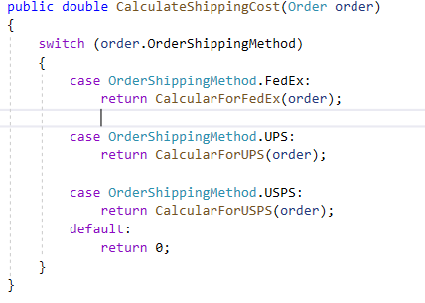
When to use it?
When you need to use several algorithms with different variations.
When you have to add new behaviours to an object
When most of your classes have related behaviours.
Notes:
Because remember the idea is to identify the parts of your program that vary and separate them from what stays the same.

Slide 10
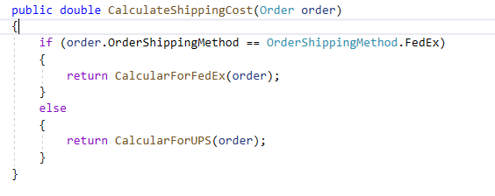
When not to use it?
When new behaviours will not be added to the class

Slide 11

Common mistakes
Forcing the pattern
Notes:
Try to apply strategy when I can solve a problem easily with an array-list-dictionary,
(keep it stupidly simple)

Slide 12

Advantages
Single Responsibility Principle.
Open/Closed Principle.
Clean code
Testability
Cyclomatic complexity
Notes:
We are following this principle while having each strategy in their correspondent class
this also very relevant, because,Strategy allows you to extend a logic in some parts of your code ("open for extension") without rewriting those parts ("closed for modification").
because you separate the concerns into classes (a class to each strategy).
Also, it is easier to test each of this classes/ strategies since they are separated and focused in a specific task
Is a software metric used to indicate the complexity of a program. It is a quantitative measure of the number of linearly independent paths through a program's source code.
We will reduce cyclomatic complexity of our application because we are separating each strategy in their correspondent class, remember whenever we use a conditional statement in our methods we are adding extra complexity to the application and adding a new behaviour that should be tested.

Slide 13
Demo
Notes:
So now, let me present a short demo of this pattern.

Slide 14

Thanks

